Slide 1
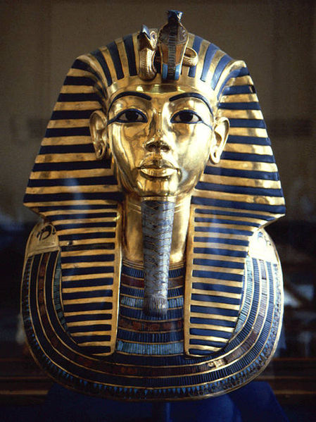
King Tut
Tutankhamun was an Egyptian pharoah of the 18th dynasty (ca. !332-1323 B.C.) during the Egyptian period of the New Kingdom. He is more popular called King Tut, his original name(Tutankhaten) meant “"Living Image of Aten”, while Tutankhamun means "Living Image of Amun". He was discovered in 1922 by Howard Carter, and George Herbert, 5th Earl of Carnarvon. No one knows of Tut’s final days and his death.

Slide 2
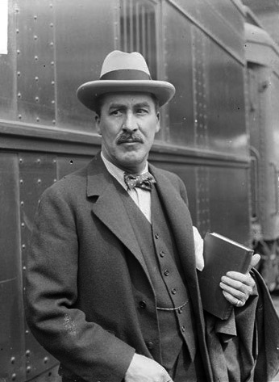
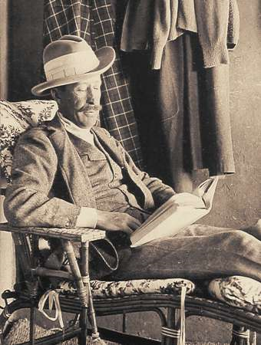
(Below) George Herbert, 5th Earl of Carnarvon an English aristocrat
(Above) Howard Carter an English archaelogist and Egyptologist

Slide 3
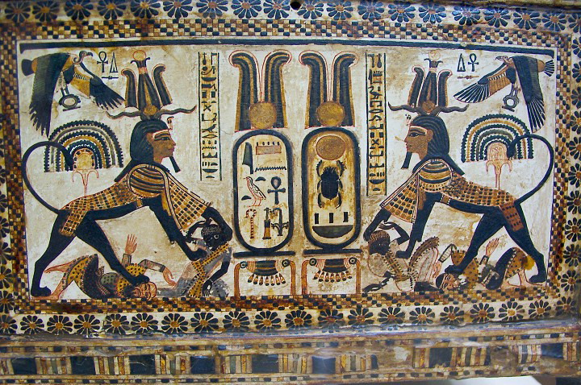
Cartouches of his birth and throne names are displayed between rampant Sekhmet lioness warrior images (perhaps with his head) crushing enemies of several ethnicities, while Nekhbet flies protectively above.

Slide 4
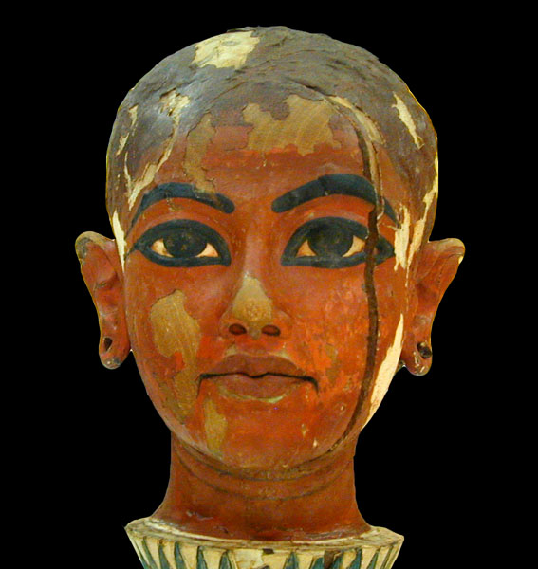
(Left) Stripped of all its jewels, the mummy of Tutankhamun remains in the Valley of the Kings in his KV62 chamber.
(Right) Bust of Tut found in his tomb, 1922

Slide 5
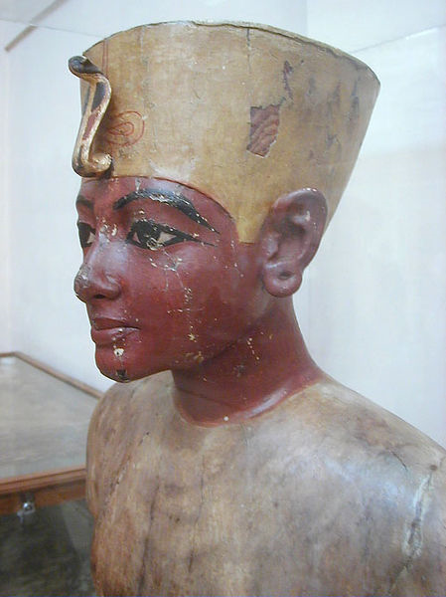
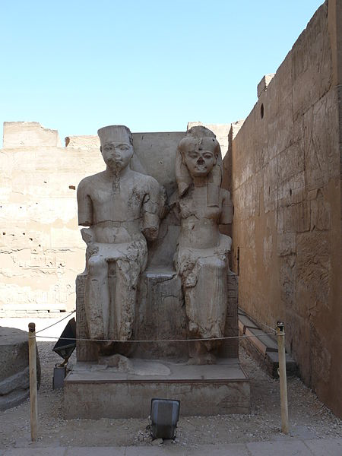
(Below)Statue of Tutankhamun and Ankhesenamun at Luxor, hacked at during the damnatio memoriae campaign against the Amarna line of Thutmoside pharaohs.
(Above)Funerary bust of the boy king, found in Saqqara

Slide 6
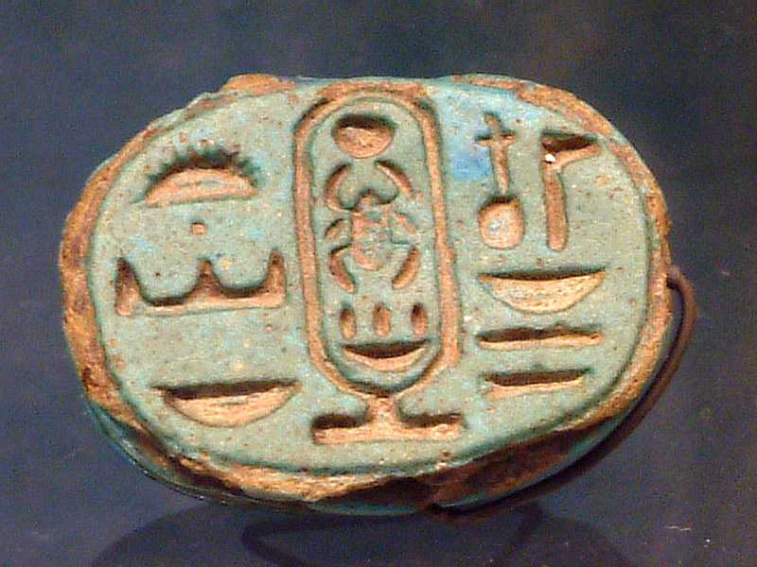
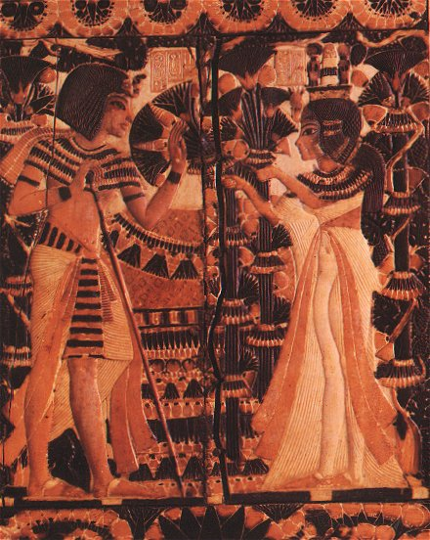
(Left) Signet ring, with cartouche, for the Pharaoh Tutankhamun:"Perfect God, Lord of the Two Lands"–('Ntr-Nfr, Neb-taui' - right to left
(Right) Tutankhamun receives flowers from Ankhesenamen

Slide 7
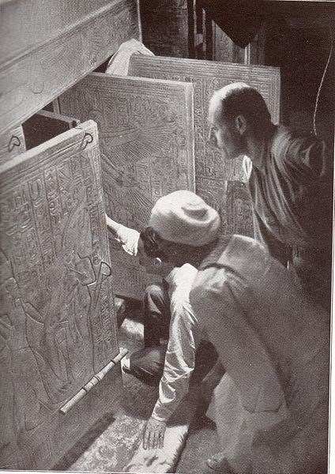
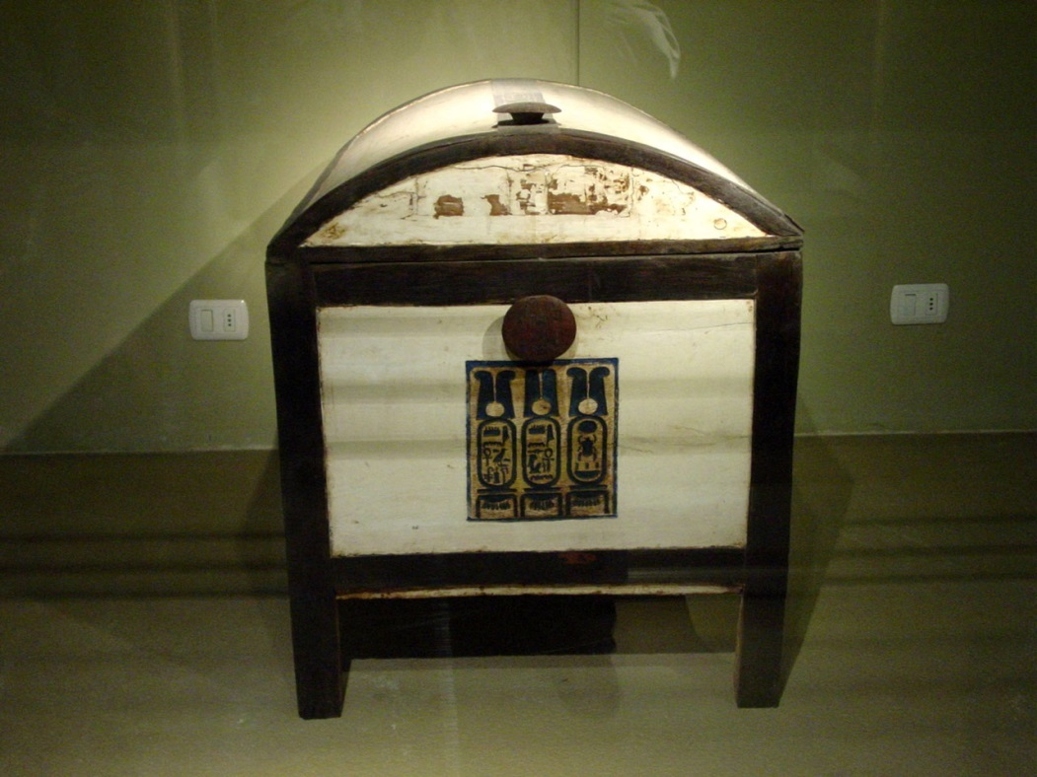
(Left) The openening of King Tut’s tomb in 1922
(Below) Tutankhamun's chest now in the Cairo Museum.
Notes:
The history of ancient Egypt is divided in three time frames: Old Kingdom, Middle Kingdom and the New Kingdom. Although not the first civilization, it was the most powerful and the longest lasting. Like all the ancient civilizations, it was POLYTHEISTIC (Re, Osiris, Isis and Horos were the most powerful, who ruled over the land and sea, and the realm of the dead).

Slide 8
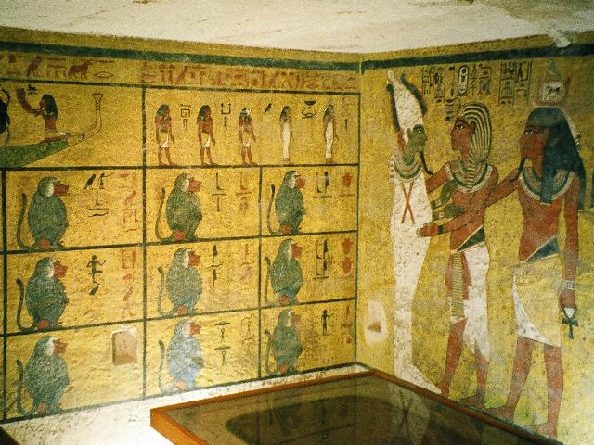
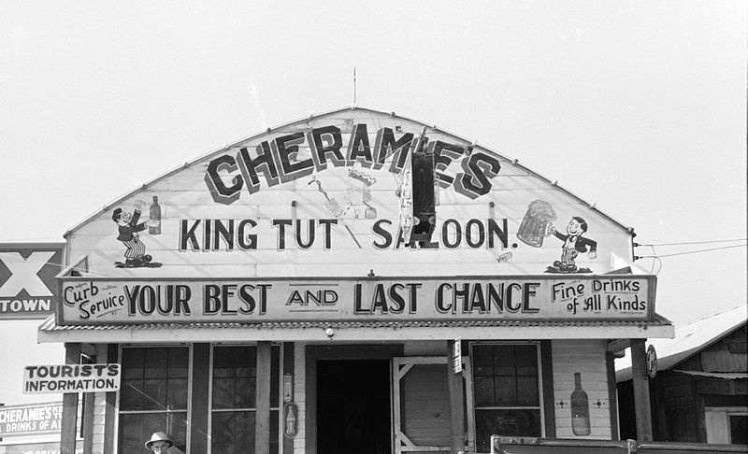
(Left) Tomb of Tutankhamun in the Valley of the Kings
(Right)"King Tut Saloon", Louisiana in case your not
in the mood for chinese

Slide 9
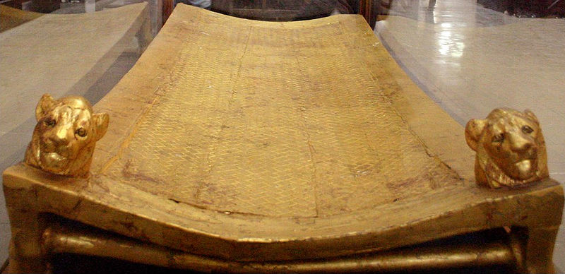
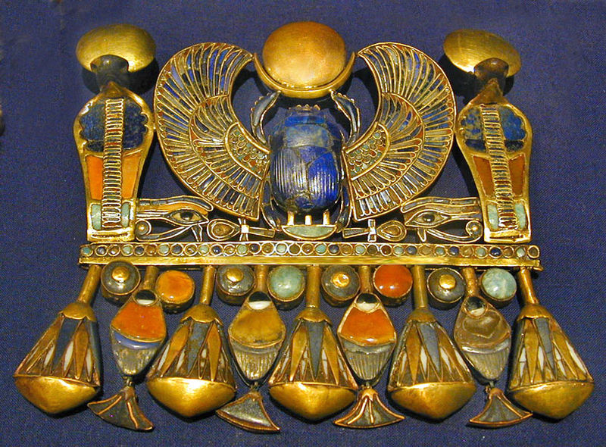
(Above) The gilded bier from the base of Tutankhamun's Sarcophagus
(Right) A pectoral belonging to Tutankhamun, representing his Prenomen

Slide 10
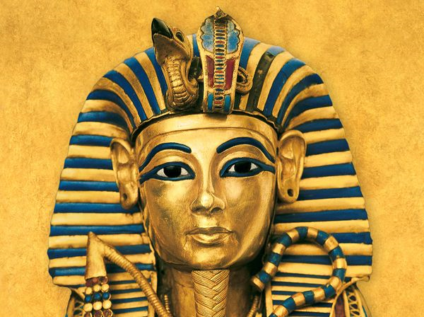
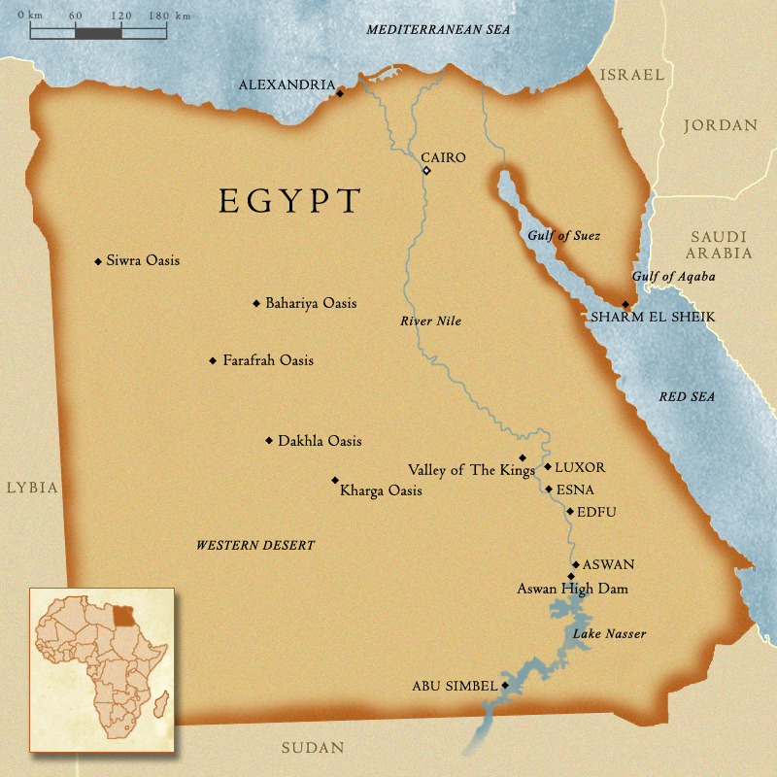
The Mask of Tutankhamun's mummy is now an icon by which every one thinks of when the topic of ancient Egypt arises.

Slide 11
ANCIENT EGYPT
The ancient Egyptian civilization developed along the banks of the NILE RIVER, the longest in the world @ 4,000 miles. The Nile Delta is called Lower Egypt, and the land upstream, to the south is called Upper Egypt.

